Slide 1

Railway Ticket Management System
Team
CS2108 Aditya Nana Bhadane
CS2165 Priyanka Sanjay Mutkule
CS2124 Atmanand Dnyaneshwar Nagpure
Course Faculty
Prof. Swati Khidse

Slide 2

Table of contents
 | Topic | Slide No.
1 | Idea | 3
2 | Demonstration | 4
3 | Code | 5
4 | Techniques | 8
5 | Conclusion | 10
6 | References/Links | 11

Slide 3
Idea
Introduction
Railway Ticket Management System is a computer based ticket booking system.
Allows users to book train tickets with ease.
Users can find trains, book train tickets, cancel ticket, and make payments.
Multiple users supported
Features
User register and login
Book a ticket, display booked tickets, cancel ticket, make payment
Display profile

Slide 4
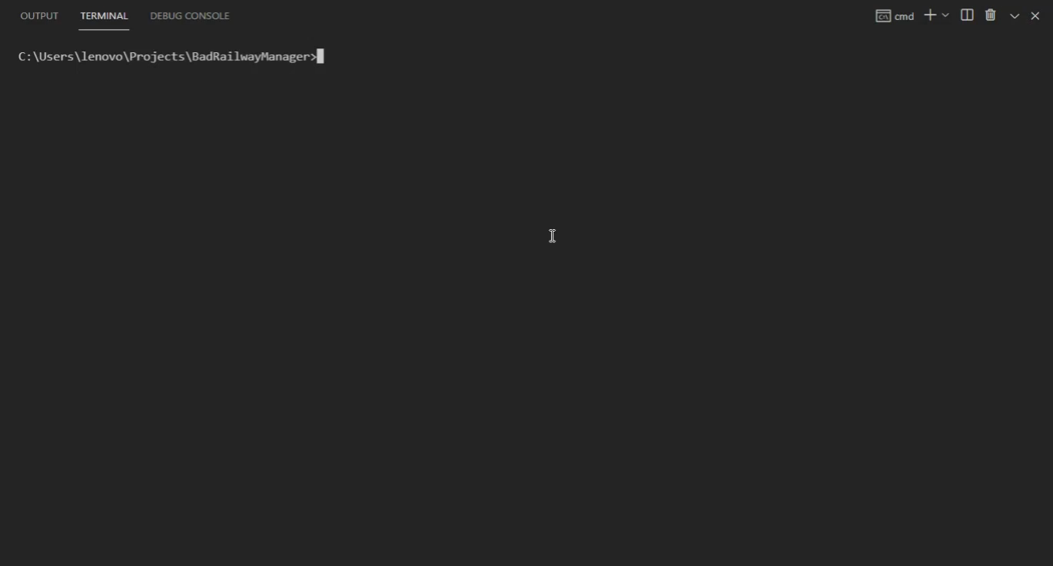
Demonstration

Slide 5
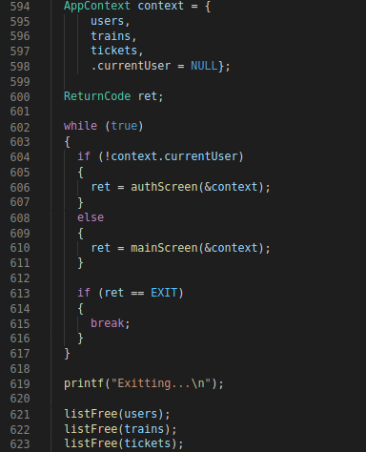
Code
Main application is divided into screens.
authScreen() handles user registration and login.
mainScreen() handles ticket booking and other operations.
All the data is saved in application’s context and is passed to all screens and components of the application.

Slide 6
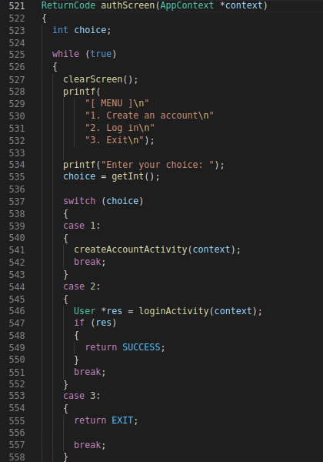
Code
Auth screen is divided into 2 options, “Create an account” and “Log in”.
createAccountActivity() function handles account creation process.
loginActivity() function handles user login process.
User can directly exit the application by choosing the “Exit” option.

Slide 7
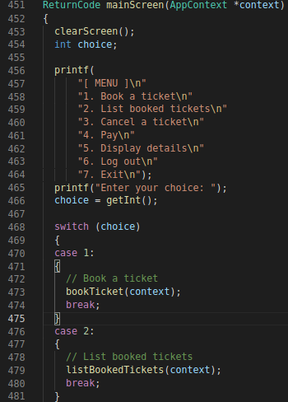
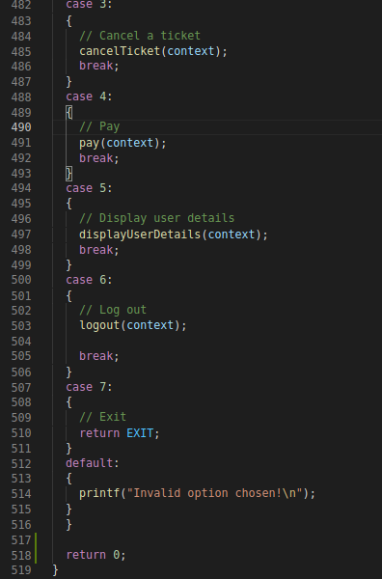
Code
Main screen provides a list of actions which a logged-in user can perform.
All actions are handled in their own functions.
Application context is passed to each action.

Slide 8
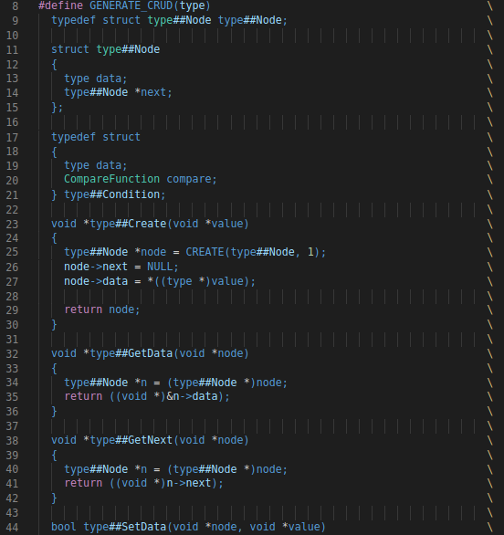
Techniques
Preprocessing
3 main entities -
User
Train
Ticket
Data is stored in linked lists.
Writing linked list each time for a new entity leads to code duplication.
C preprocessing macros were used to generate CRUD (Create, Read, Update, Delete) functionality automatically.

Slide 9
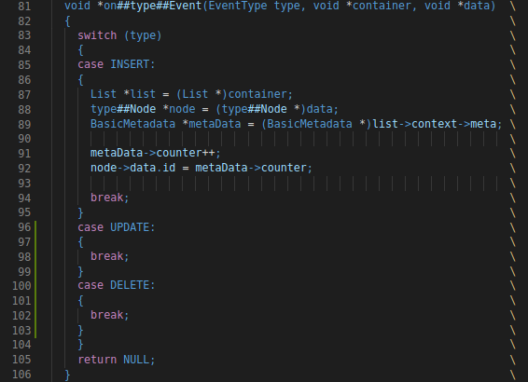
Techniques
Event Handling
List events -
Insert
Update
Delete
Event handlers can be added to perform operations after a list action is performed.
For eg., after an element is inserted in the list, the inserted element can be written to a file or saved in a database.
Fig. Event handler increments the element counter and gives an ID to the newly inserted element.

Slide 10
Conclusion
Data structures provide a simple interface and abstract out the complexity.
Design patterns simplify the application flow and help in creating a consistent, repeatable design process.
For writing applications rapidly, the structure of code has to be consistent yet flexible.
Code can be divided into modules to allow multiple developers to work on the project.

Slide 11
References/Links
Source Code
- GitHub: https://github.com/proghax333/BadRailwayManager

Slide 12

Thank you!

